Slide 1
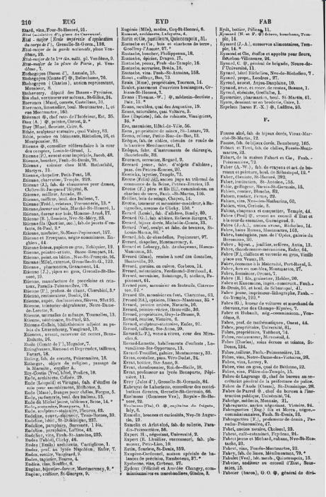
Paris Address book of the past
DH-405 Foundations of Digital Humanities
Lea Marxen and Ben Kriesel
22 – 12 - 22

Slide 2
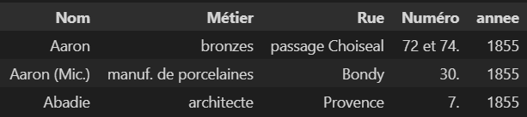
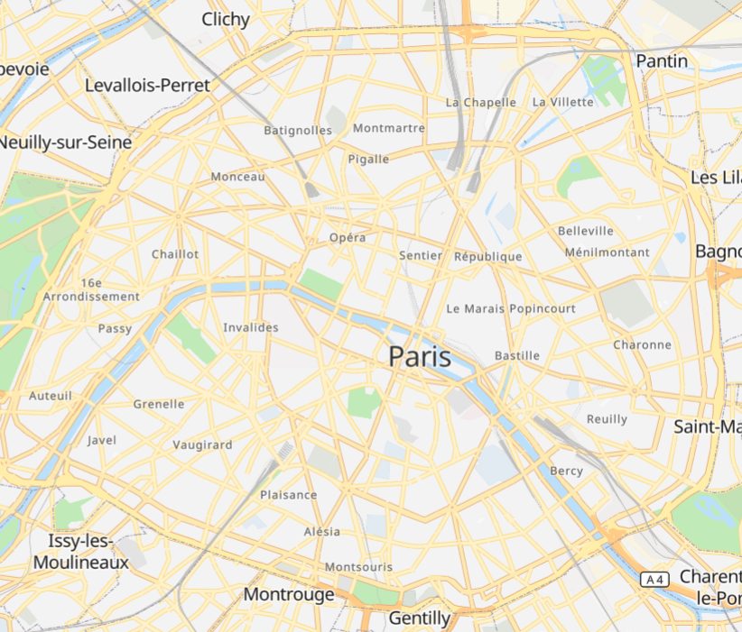
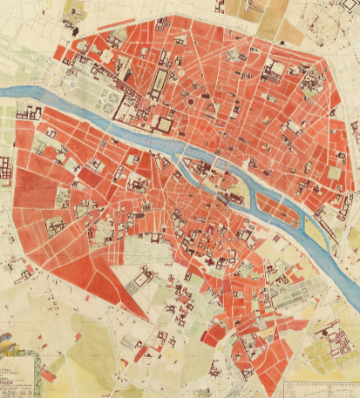
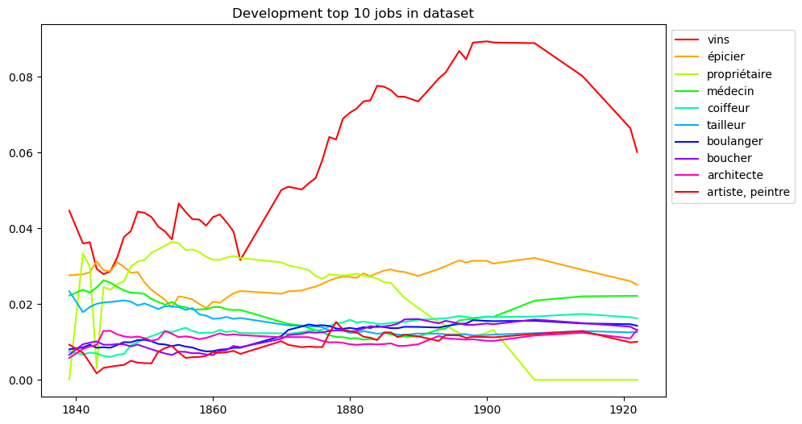




Project
Alignment
Preprocessing
Align two street network datasets
Align Bottin data
Quality Assessment
Analysis
Development of Professions and Streets
Case Studies
1839 - 1922

Slide 3
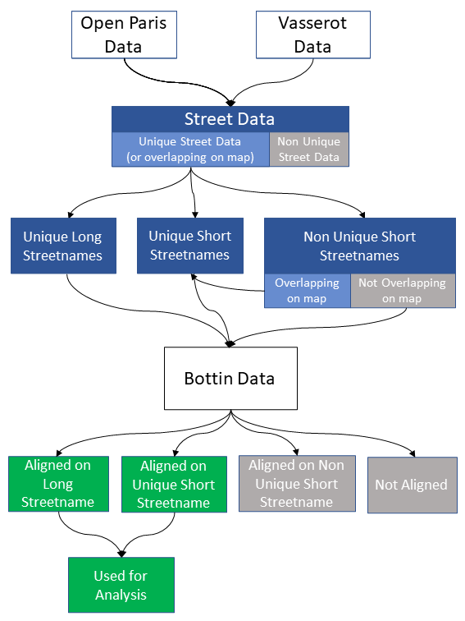
Alignment

Slide 4
Alignment

Slide 5
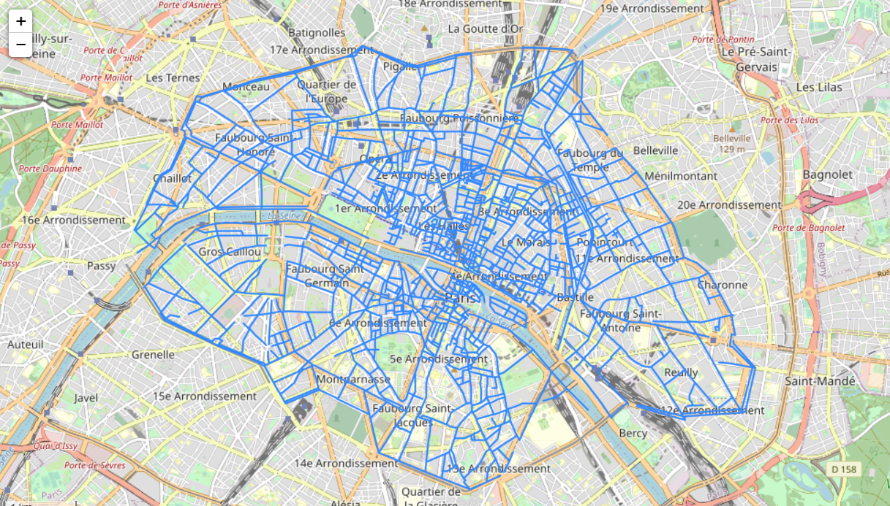
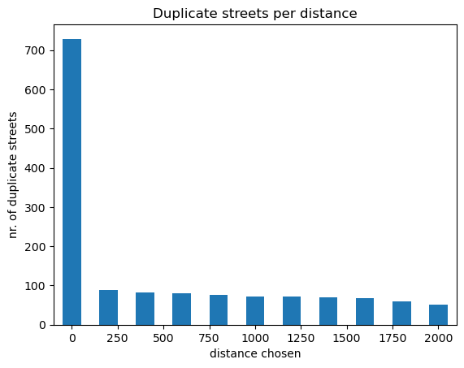
Street Processing

Slide 6
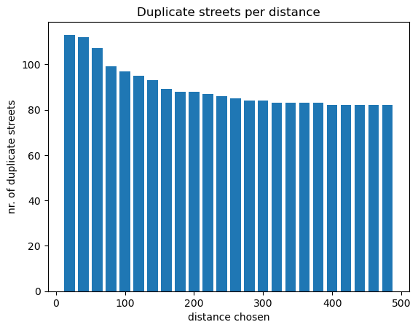
Street Processing

Slide 7
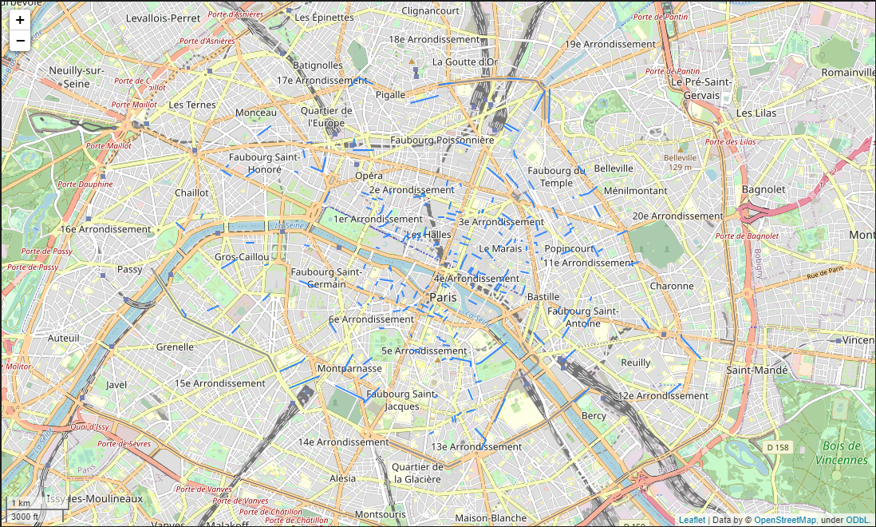
Street Processing

Slide 8
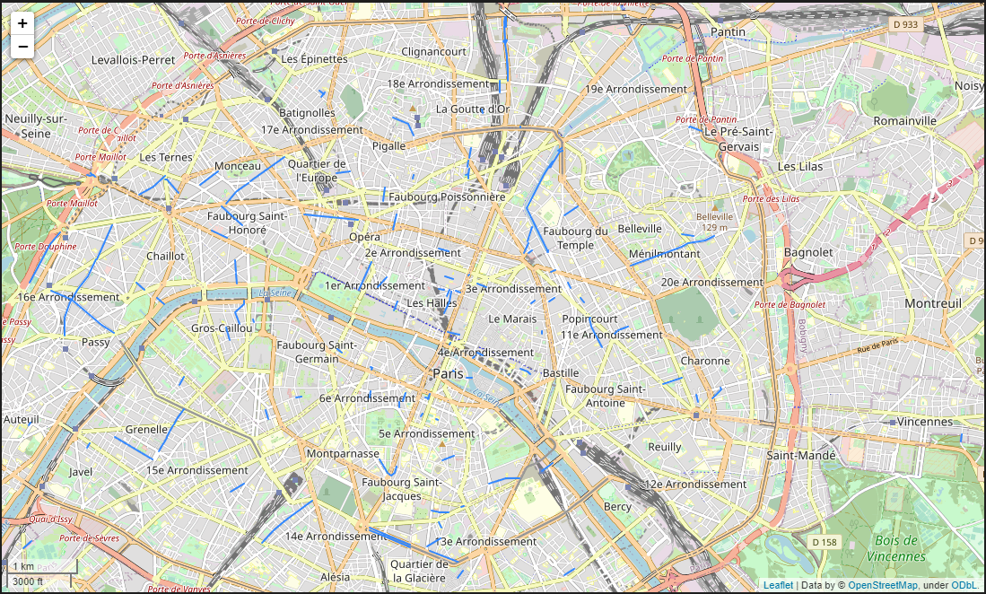
Street Processing

Slide 9
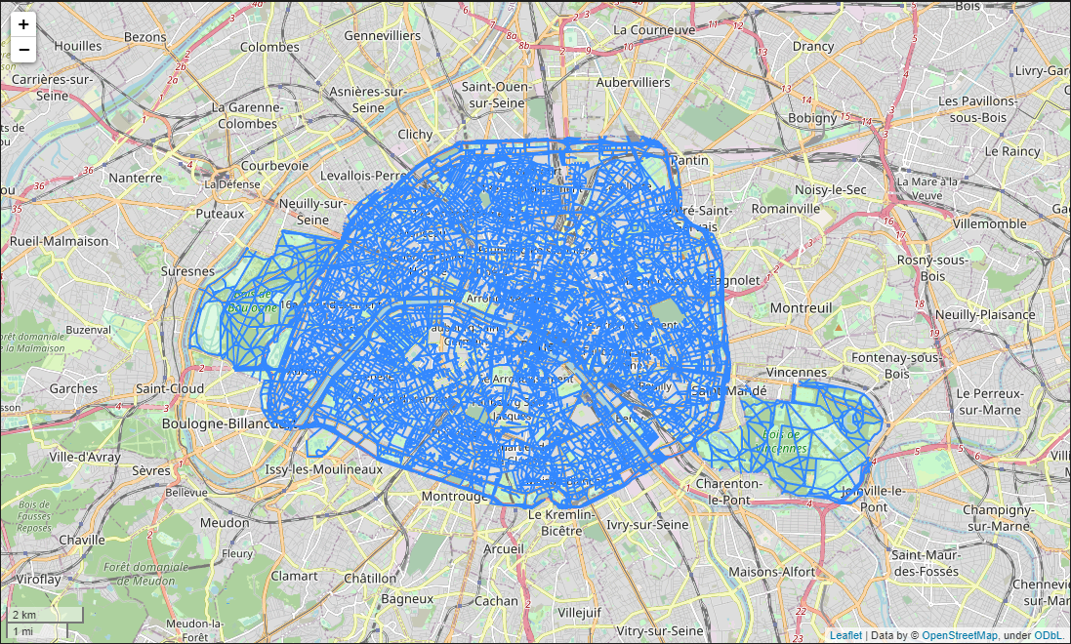
Street Processing

Slide 10
Street Processing

Slide 11
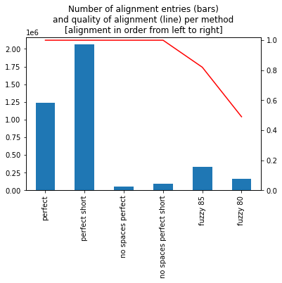
Alignment of Bottin Data
 | Total aligned | % of aligned data | % of all data | Quality of alignment
Perfect | 1.2 Mio | 31.5 | 28 | 100%
Perfect short | 2 Mio | 52.5 | 47 | 100%
No spaces | 56‘000 | 2 | 1 | 100%
No spaces short | 89‘000 | 2 | 2 | 100%
Fuzzy 85 | 330‘000 | 8 | 7 | 82%
Fuzzy 80 | 160‘000 | 4 | 4 | 49%
 | 3.9 Mio | 100 | 89 | 96%
Probability(error) = 0.88 * 0 + 0.08 * 0.18 + 0.04 * 0.51
= 0.0348

Slide 12
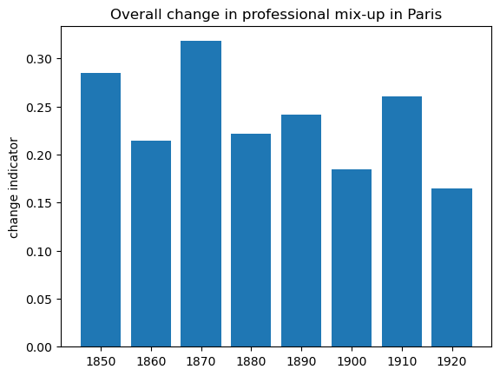
Analysis

Slide 13
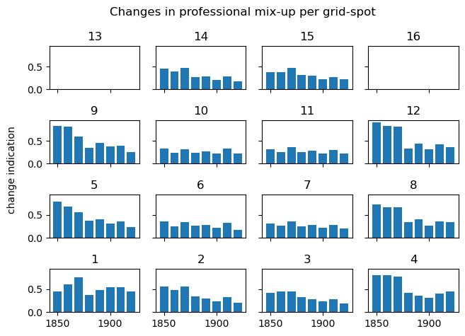
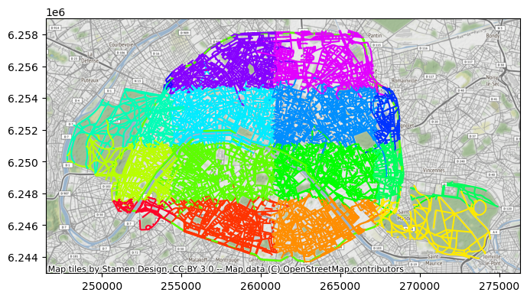
Analysis

Slide 14
Professions

Slide 15
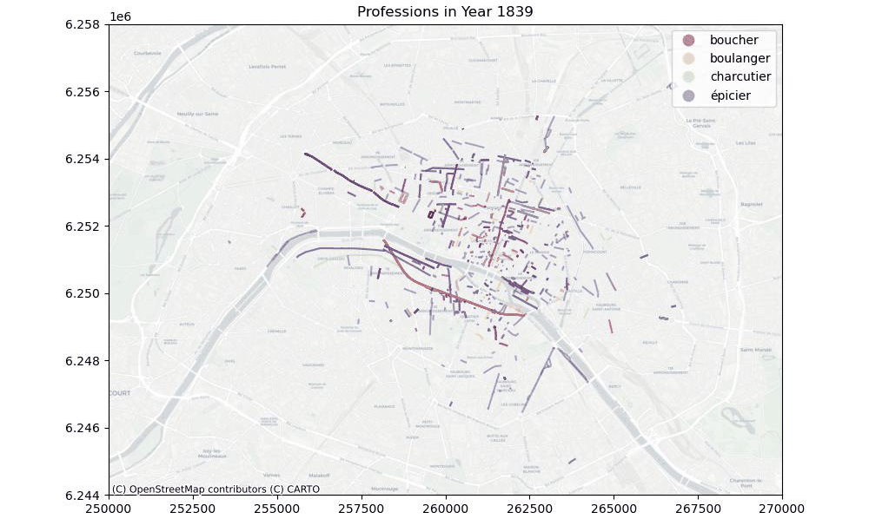
Professions

Slide 16
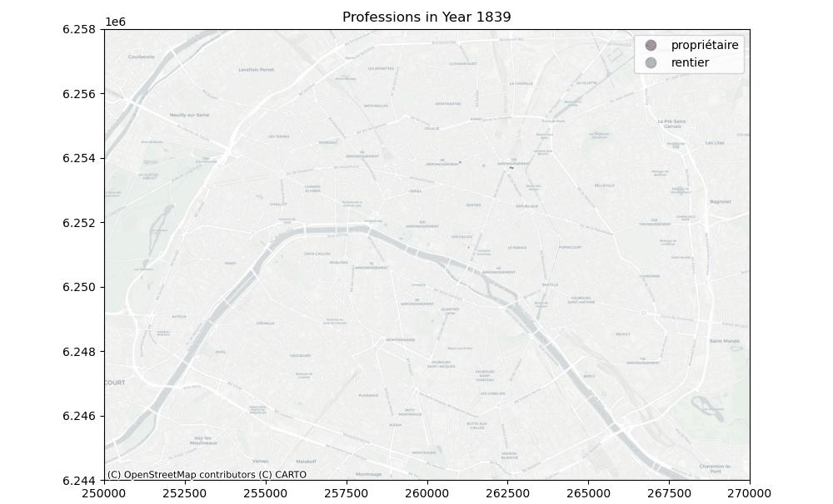
Professions

Slide 17
Rare Professions
Jobs only before 1880
'toiseur', 'grènetier', 'prop', 'pair', 'lettres', 'pension', 'huile', 'mérinos', 'accordeur', 'garni', 'bonnets'
Jobs only after 1880
'cannage', 'électriciens', 'garage', 'jerseys', 'postiches', 'massage', 'pneumatiques', 'décolleteur', 'bicyclettes', 'charbonnière', 'importateurs', 'outillage', 'brocanteuse', 'reconnaissances', 'ravalements', 'stoppeuse', 'triperie', 'automobiles', 'bar', 'masseur', 'décolletage', 'patrons', 'phototypie', 'masseuse', 'cycles', 'alimentation'

Slide 18
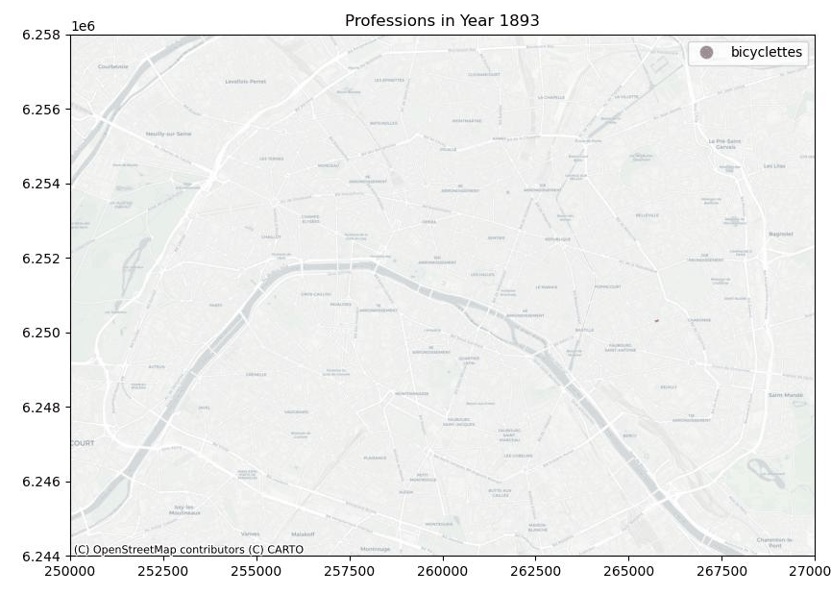
Rare Professions

Slide 19
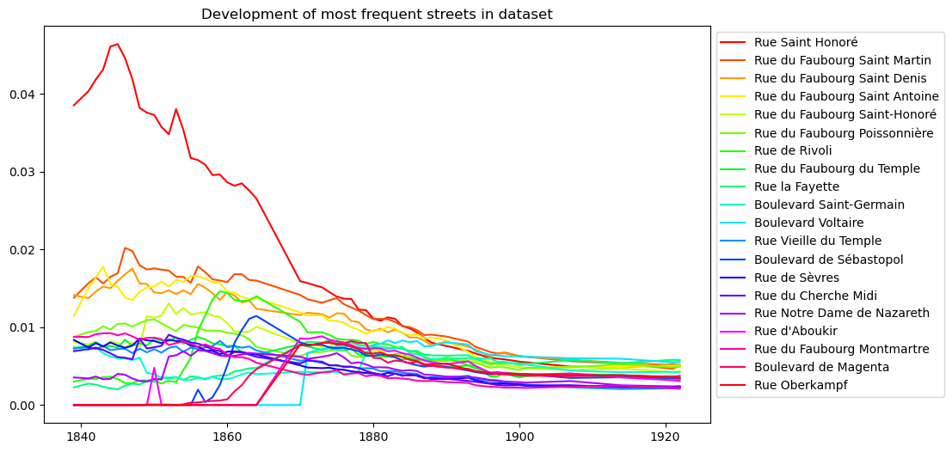
Streets

Slide 20
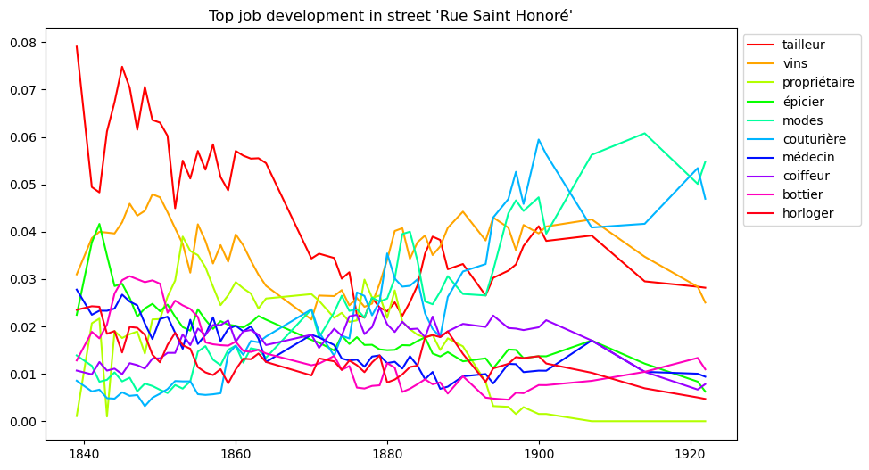
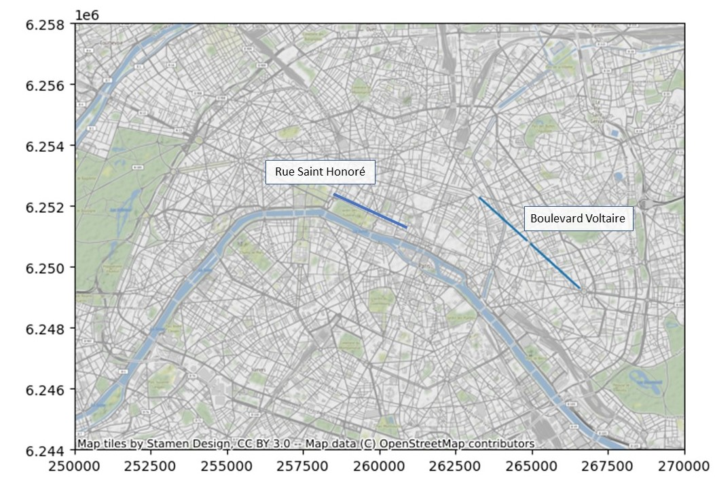
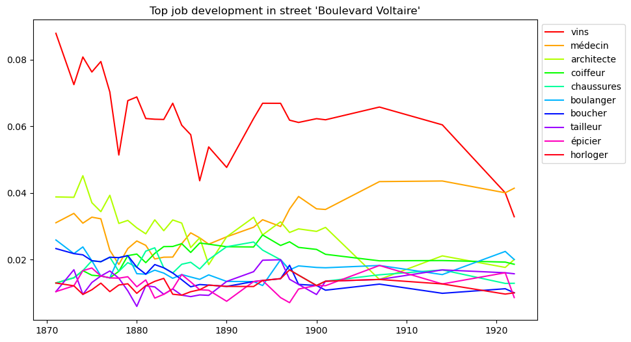
Case Study
Rue Saint Honoré &
Boulevard Voltaire

Slide 21
Limitations
&
Future Directions
Combination of OCR Mistakes & abbreviations
Missing streets
Ambiguous streetnames
Matching on street level
Profession tags
Small part of potential analysis
Perfection of Alignment
Address numbers
Additional street data
Short street data alignment
Use whole datapoint for alignment
Include building/destruction dates for streets
Further Analysis
Cluster Professions
Further analysis: gentrification, development of arrondissements, influence of political decisions
Visualization: interactive map

Slide 22
Thank you!

